Slide 1

2015

Slide 2
Dates
2 Weeks
5 to 19 July 2015
19 July to 2 August 2015
3 Weeks
5 July to 26 July 2015
Age group: 11-17 years old

Slide 3
Why Summers Abroad?
Great Location
Unique Interactive Programme
Personal Care and Attention
Excellent Value for Money
25 Years Experience

Slide 4
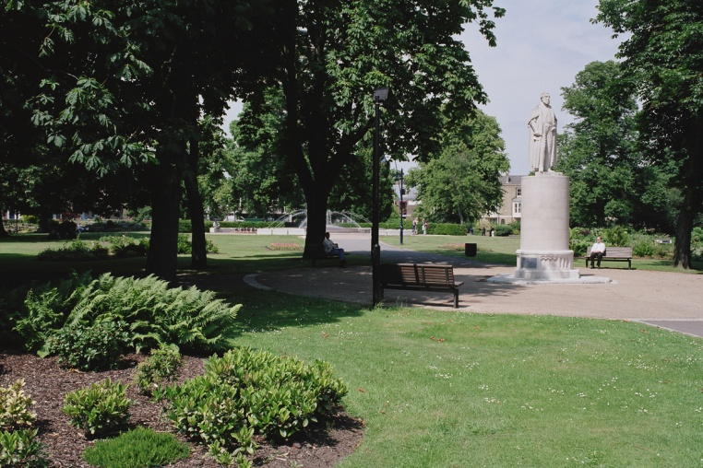

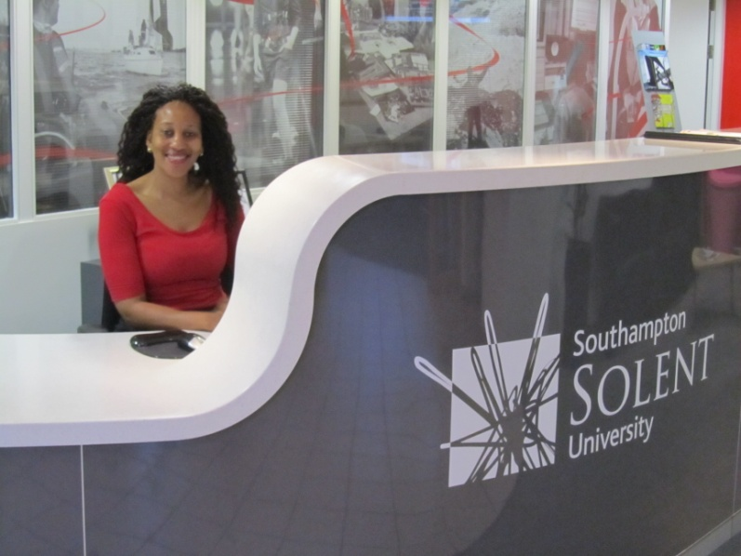
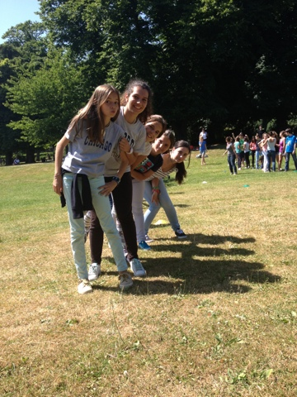
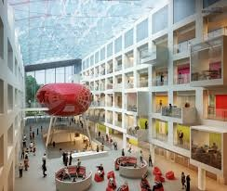
Great Location!
Southampton and

Slide 5
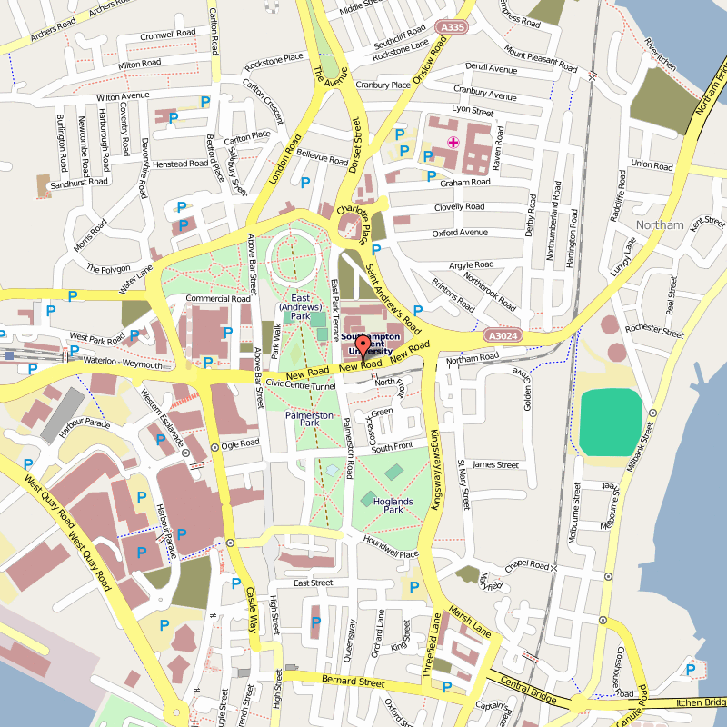
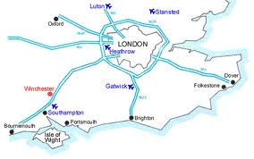
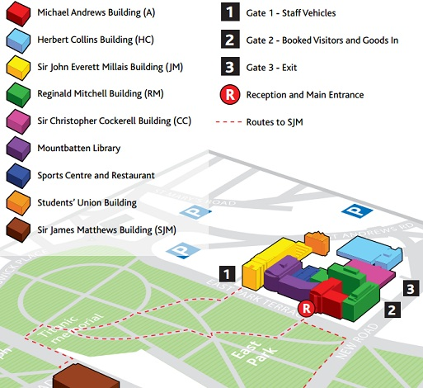
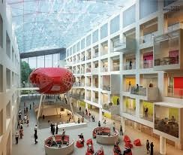

Slide 6

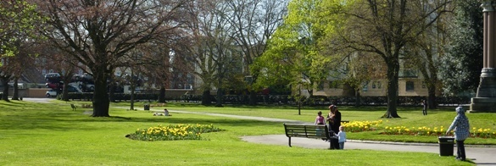
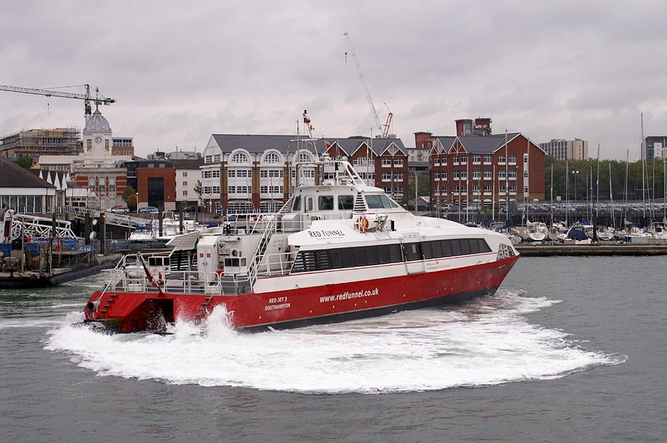
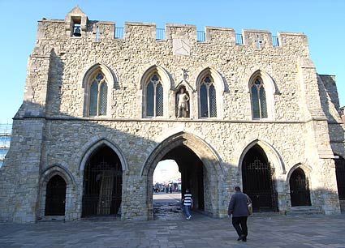
Southampton

Slide 7
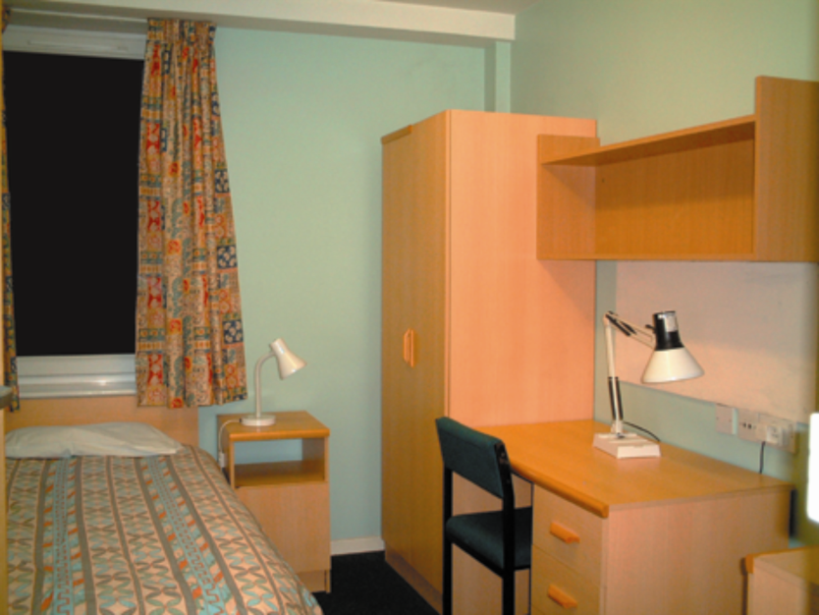
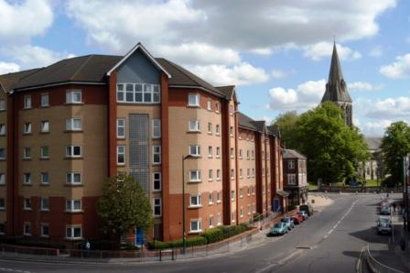
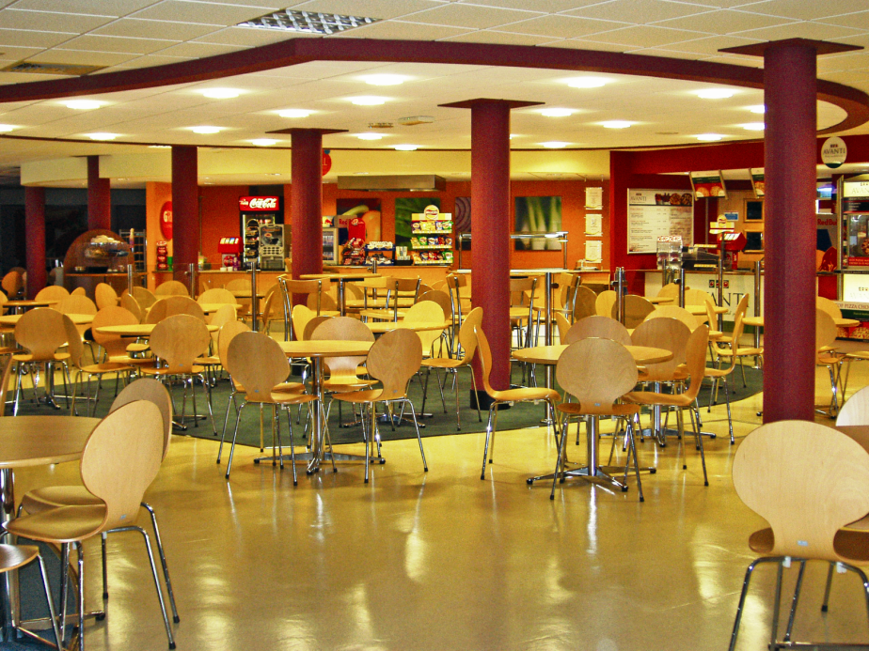
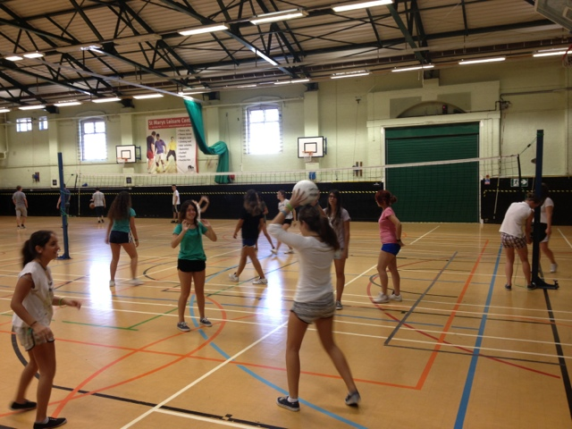
Excellent University Facilities

Slide 8
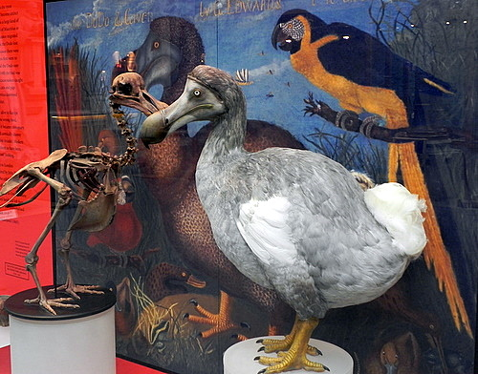
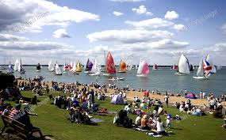
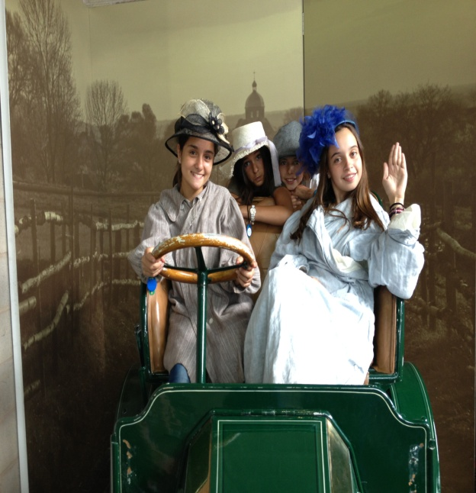
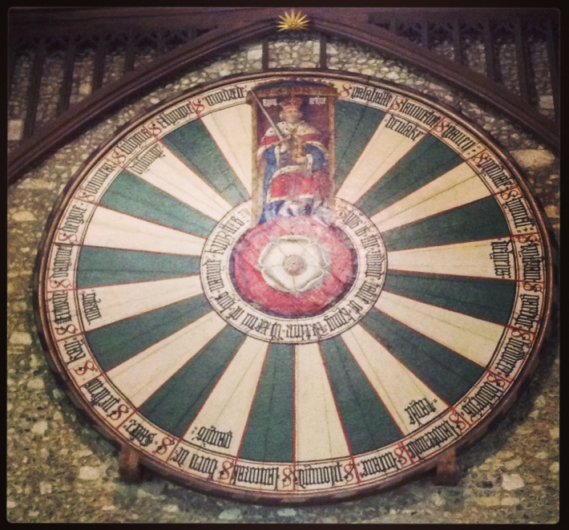
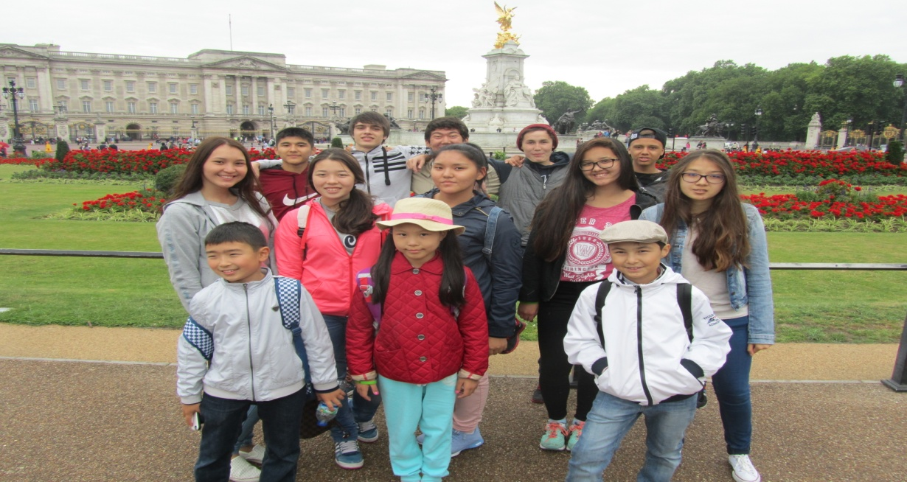
Summers Abroad Excursions!
Beaulieu
Oxford
Isle of Wight
Winchester
London

Slide 9

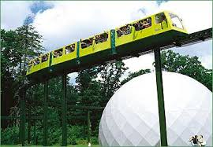
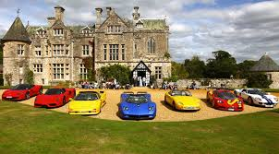
Summers Abroad Excursions!
Students enjoy the varied excursions which include a full day excursion to London (with a walking tour of main sights)and Oxford (with a visit to Oxford University’s Museum of Natural History and Pitt Rivers Museum.
The three half day excursions are to the top attraction in the South of England, Beaulieu (national motor museum, monorail railway, Victorian double-decker bus, stately home, abbey), one of England’s most beautiful English cities, Winchester, and an exciting Red Jet catamaran trip to Cowes on the Isle of Wight.

Slide 10



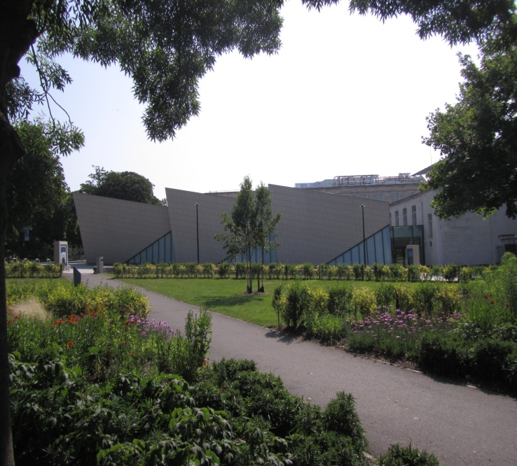
Unique Interactive Programme
Teams - Bears against Rabbits
Titanic – Sea City, Titanic Project

Slide 11
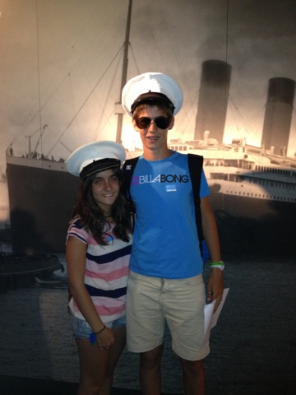
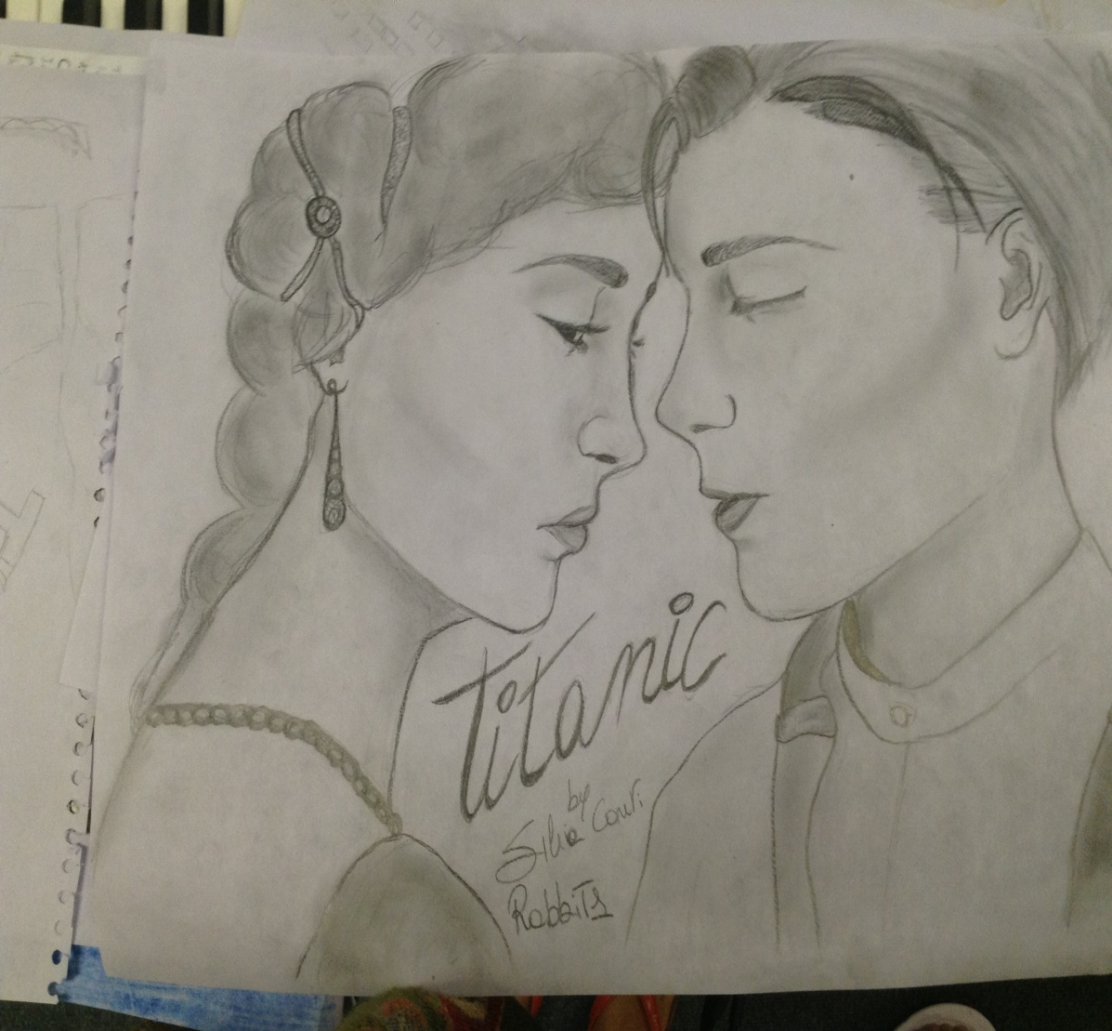
Titanic Project

Slide 12
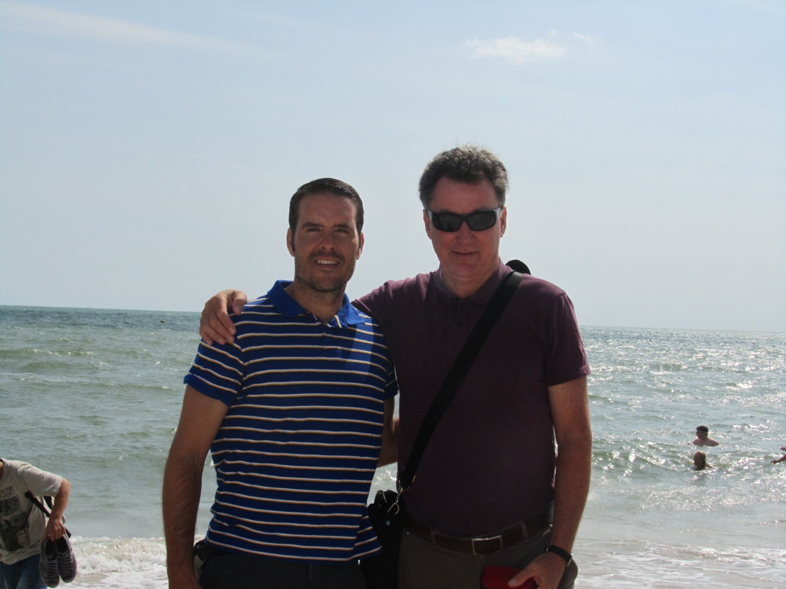
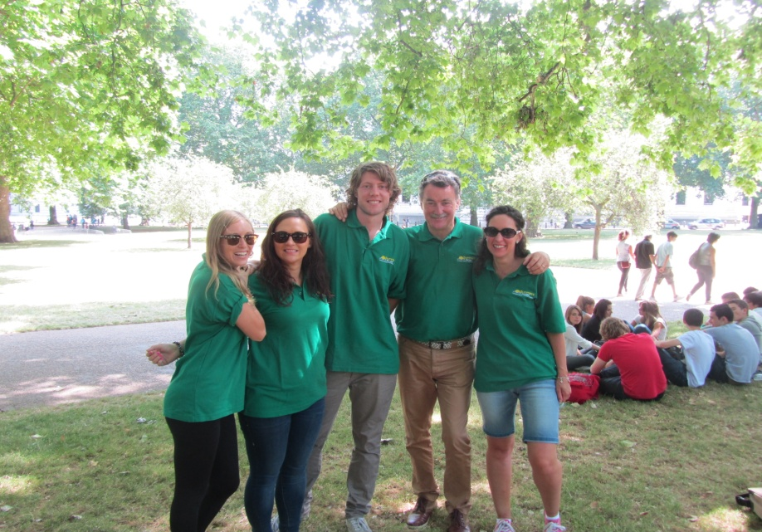
Personal Care and Attention

Slide 13
Russell Lynch Director
25 years experience of organising JUNIOR summer residential programmes.
30 years teaching experience in the UK, Africa and Italy, including at the prestigious Peterhouse School in Zimbabwe, and at Milan, Siena and Florence Universities in Italy.

Slide 14
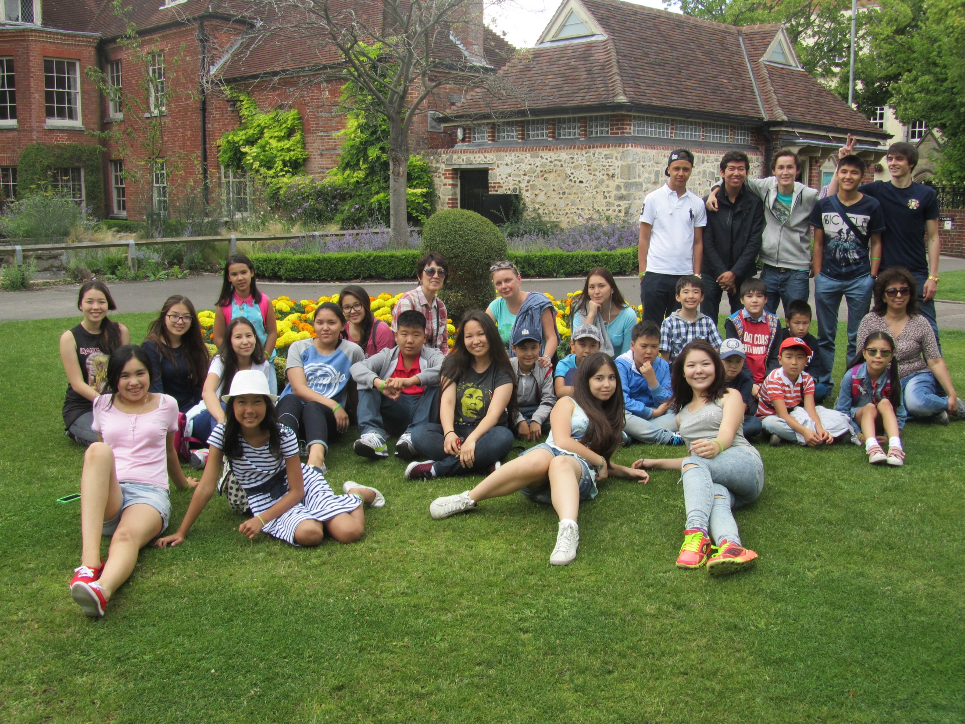

Slide 15
The Language Course
Fully Qualified and Experienced Teachers
Maximum 15 students per class
International Classes
Up-to-date Teaching Material and Modern Didactic Methods.
Students interviewed individually
Certificates of attendance and detailed progress reports
15 Hours tuition per week plus Titanic Project with teachers
Prizes to students who have made most progress
Graded readers to encourage vocabulary development.
A diary competition with prizes.

Slide 16


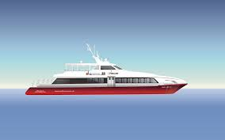
Excellent Value for Money!
Ten Pin Bowling 2 Full Day Excursions – 2 week course
Circus Skills Workshop 3 Half Day Excursions – 2 week course
Country Line Dancing Team Competition with Prizes/ Prizes for Best Students
Local Swimming Pool Single Room Accommodation
Tokyo Bar Disco 3 Full Day Excursions – 3 week course
Sea City Museum 5 Half Day Excursions – 3 week course
Top Attraction Beaulieu Airport Transfers/Free Group Leader Places
Red Jet Ferry

Slide 17
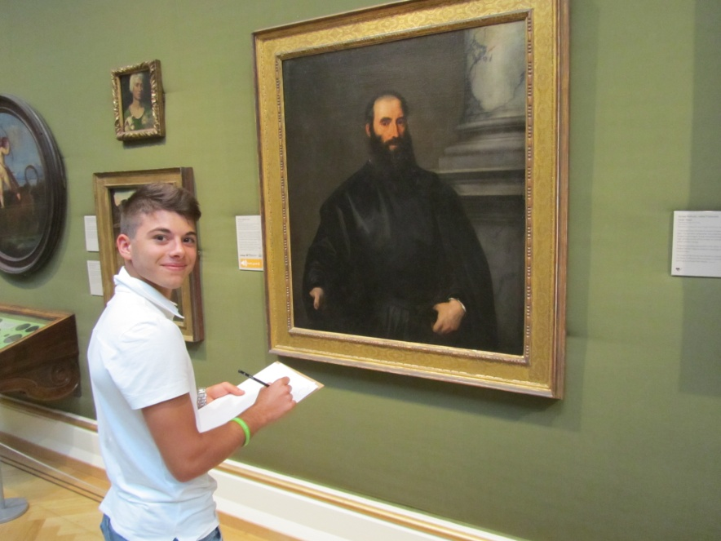
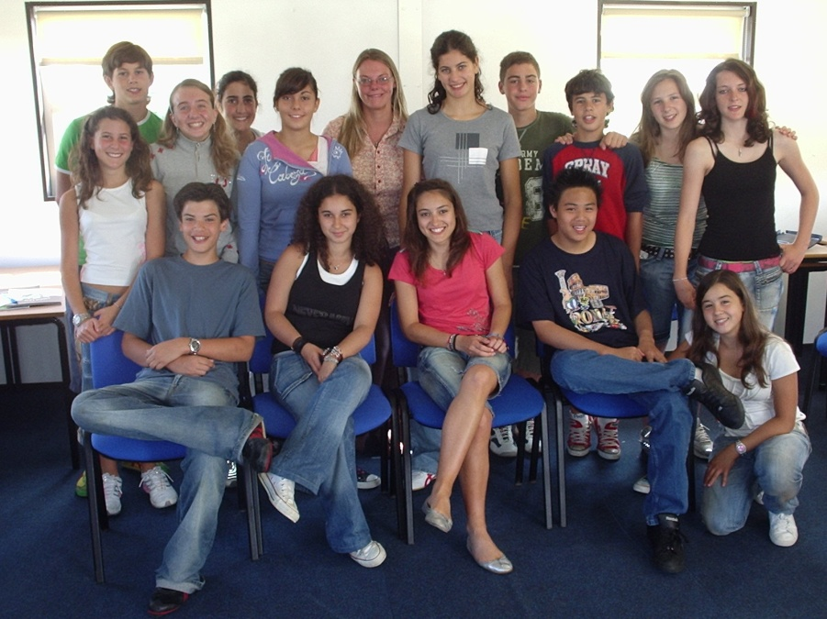
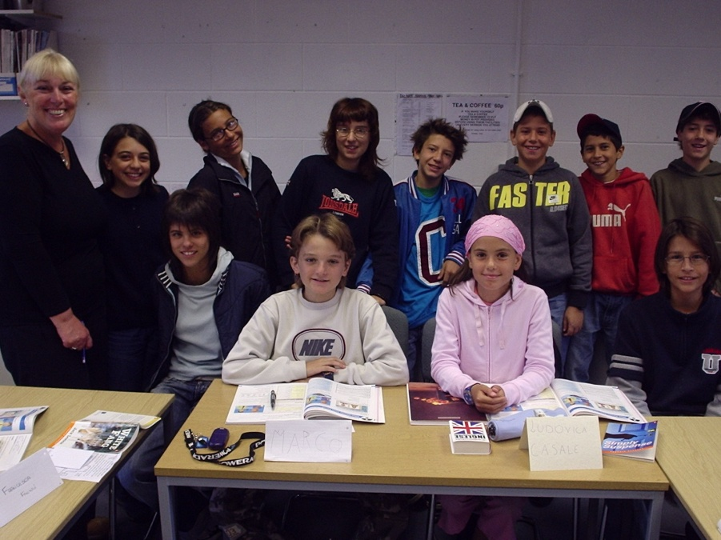
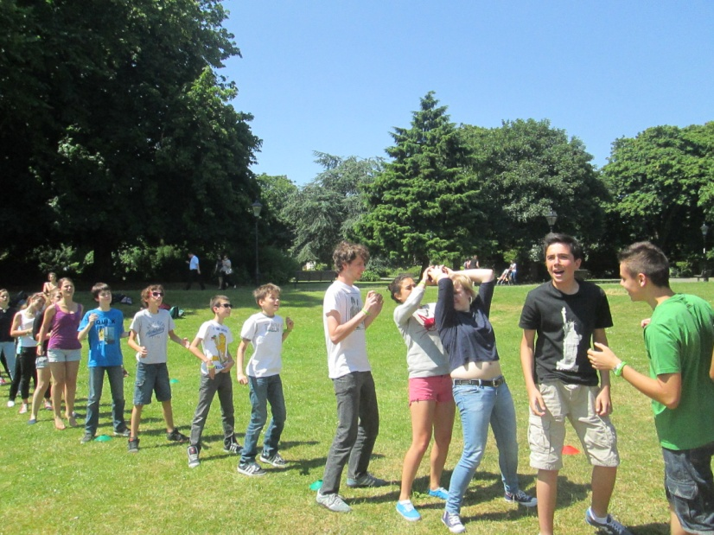
Summers Abroad - Learning English Amongst Friends

Slide 18
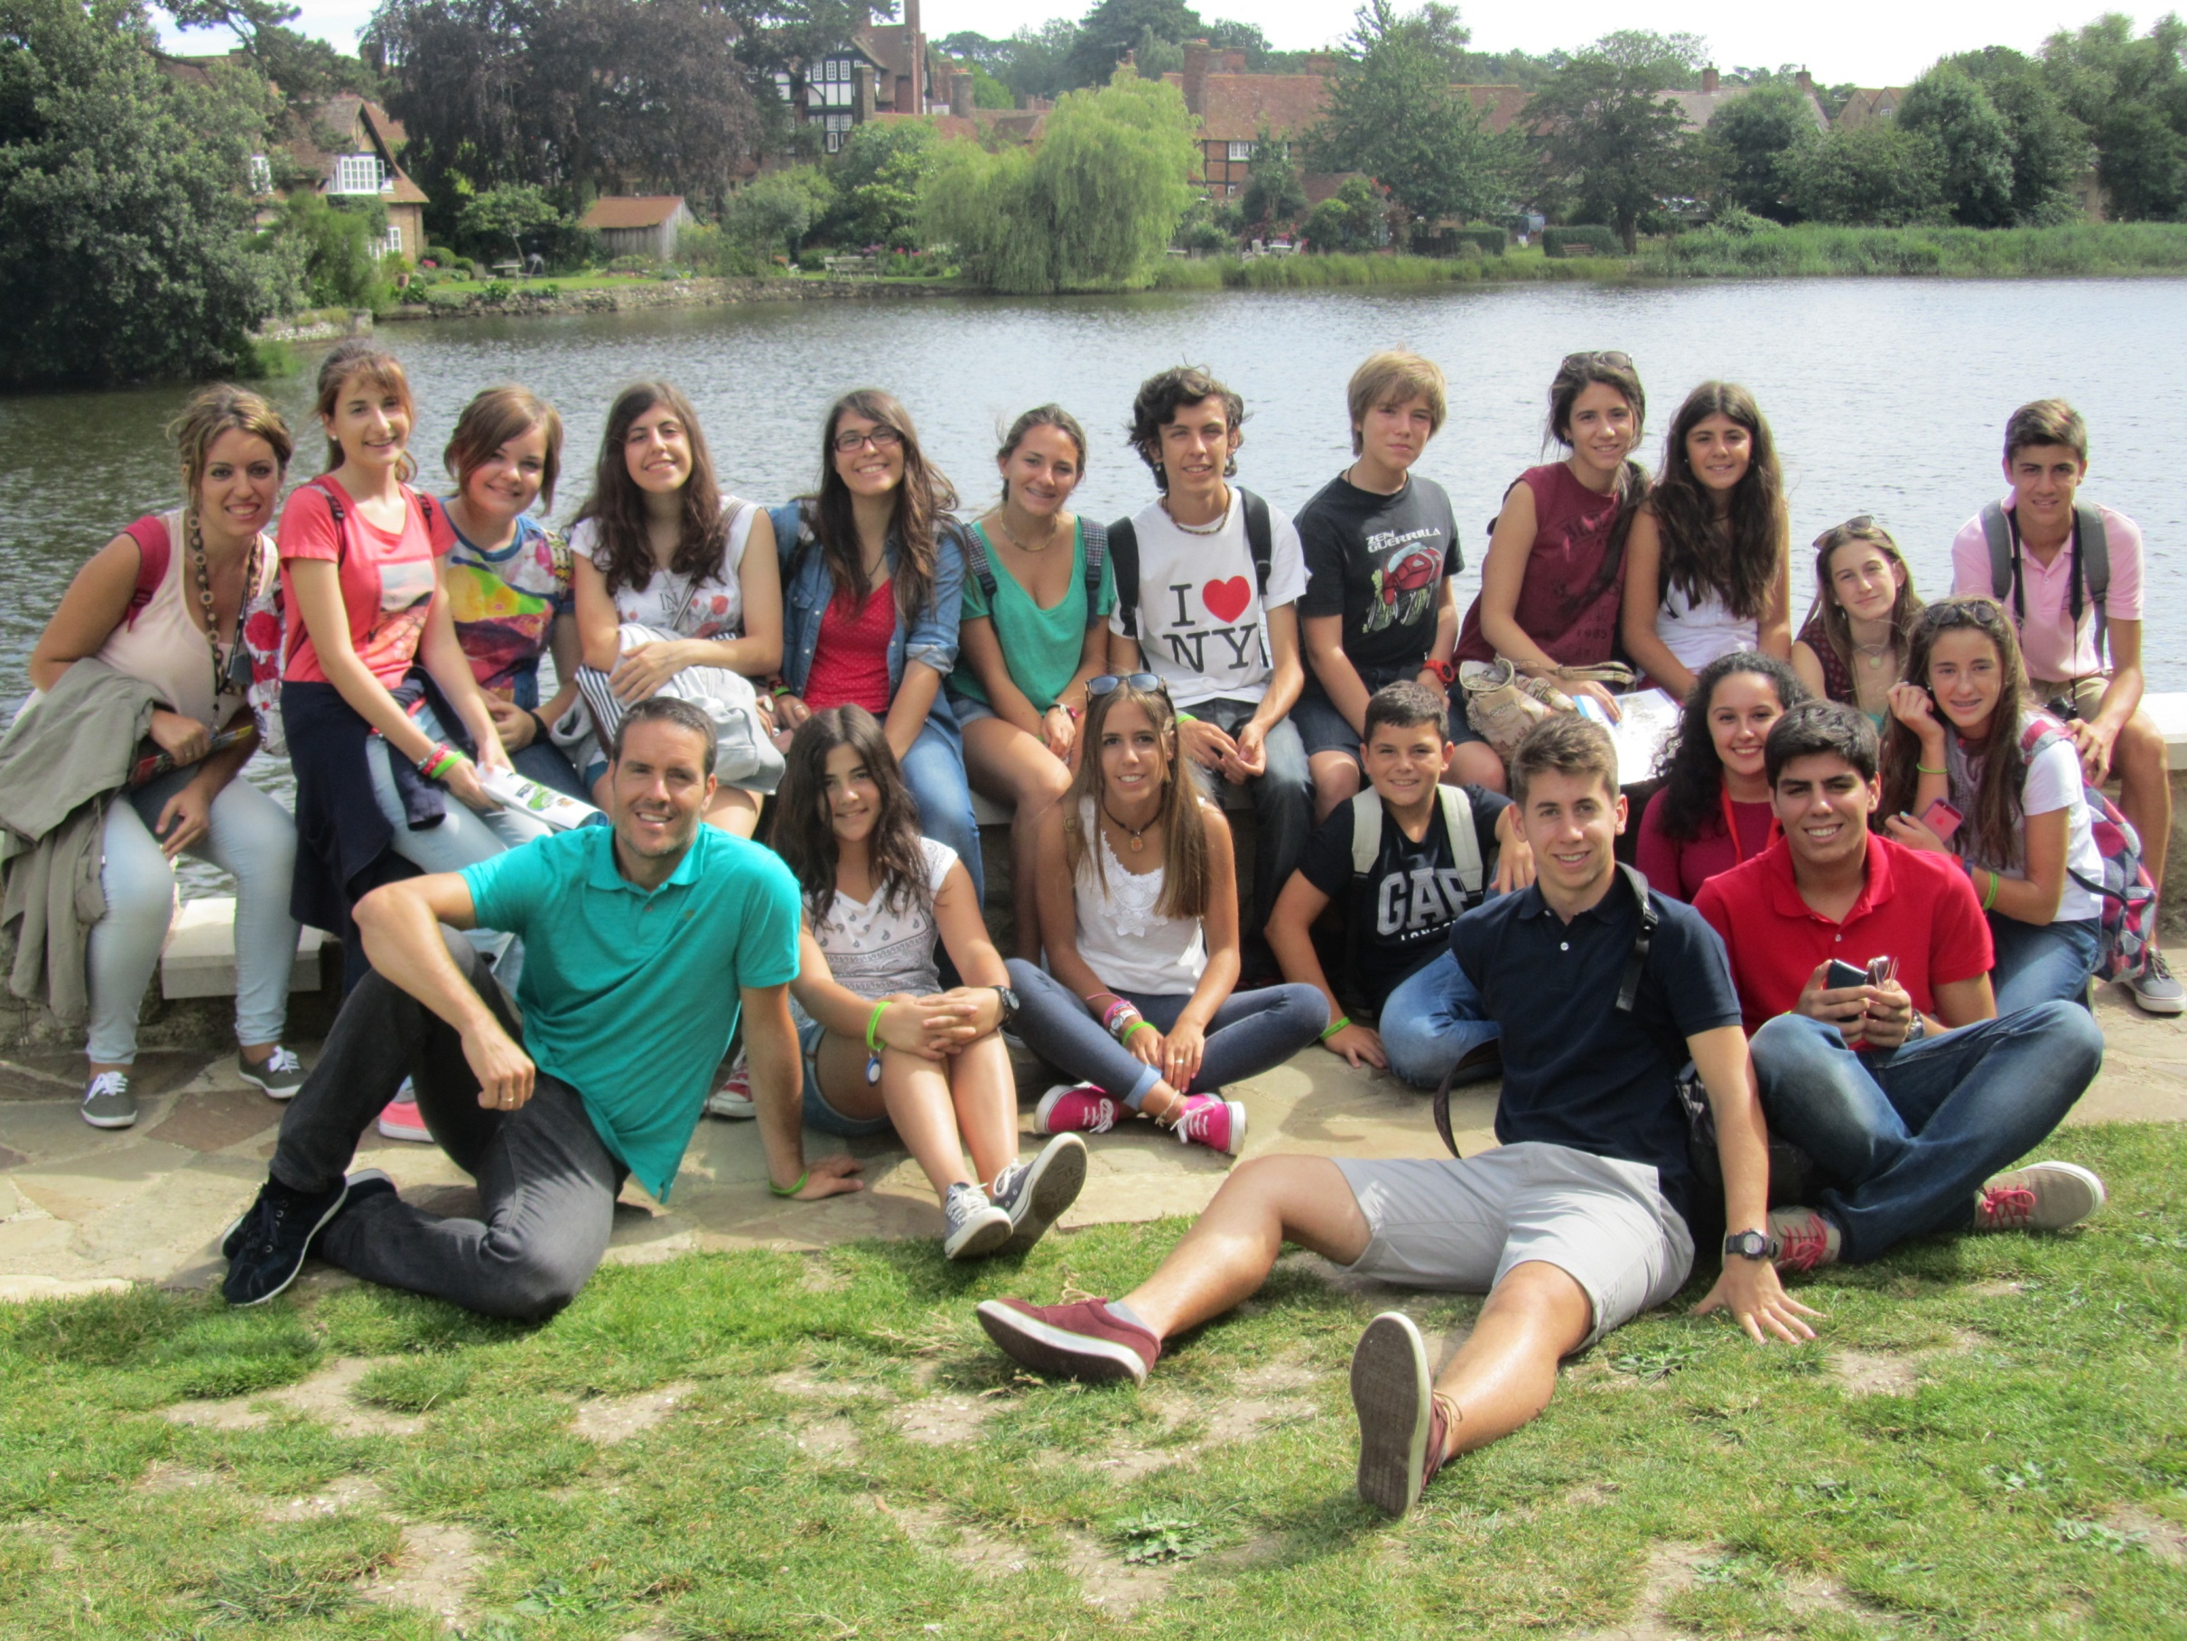

Slide 19
Summers Abroad
Come and join us in 2015!

